Slide 1
3 Axis Pin Development Update
Week #11

Slide 2
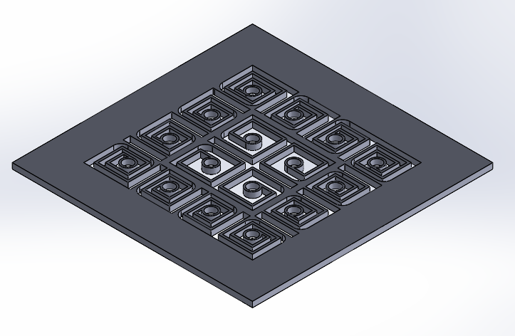
Currently using Swirly Pivot Mount V2
Need to figure out a better way to attach rods to slots
Set Screws, like on current design

Slide 3
Actuator + Pulley System

Slide 4

1st Normal Mode Frequency (Clamped at both ends)
Area Moment of Inertia (Solid Cross Section): I = pi r^4/4 = 0.2485
Need to check units: getting really weird results (<0.6 mm)

Slide 5
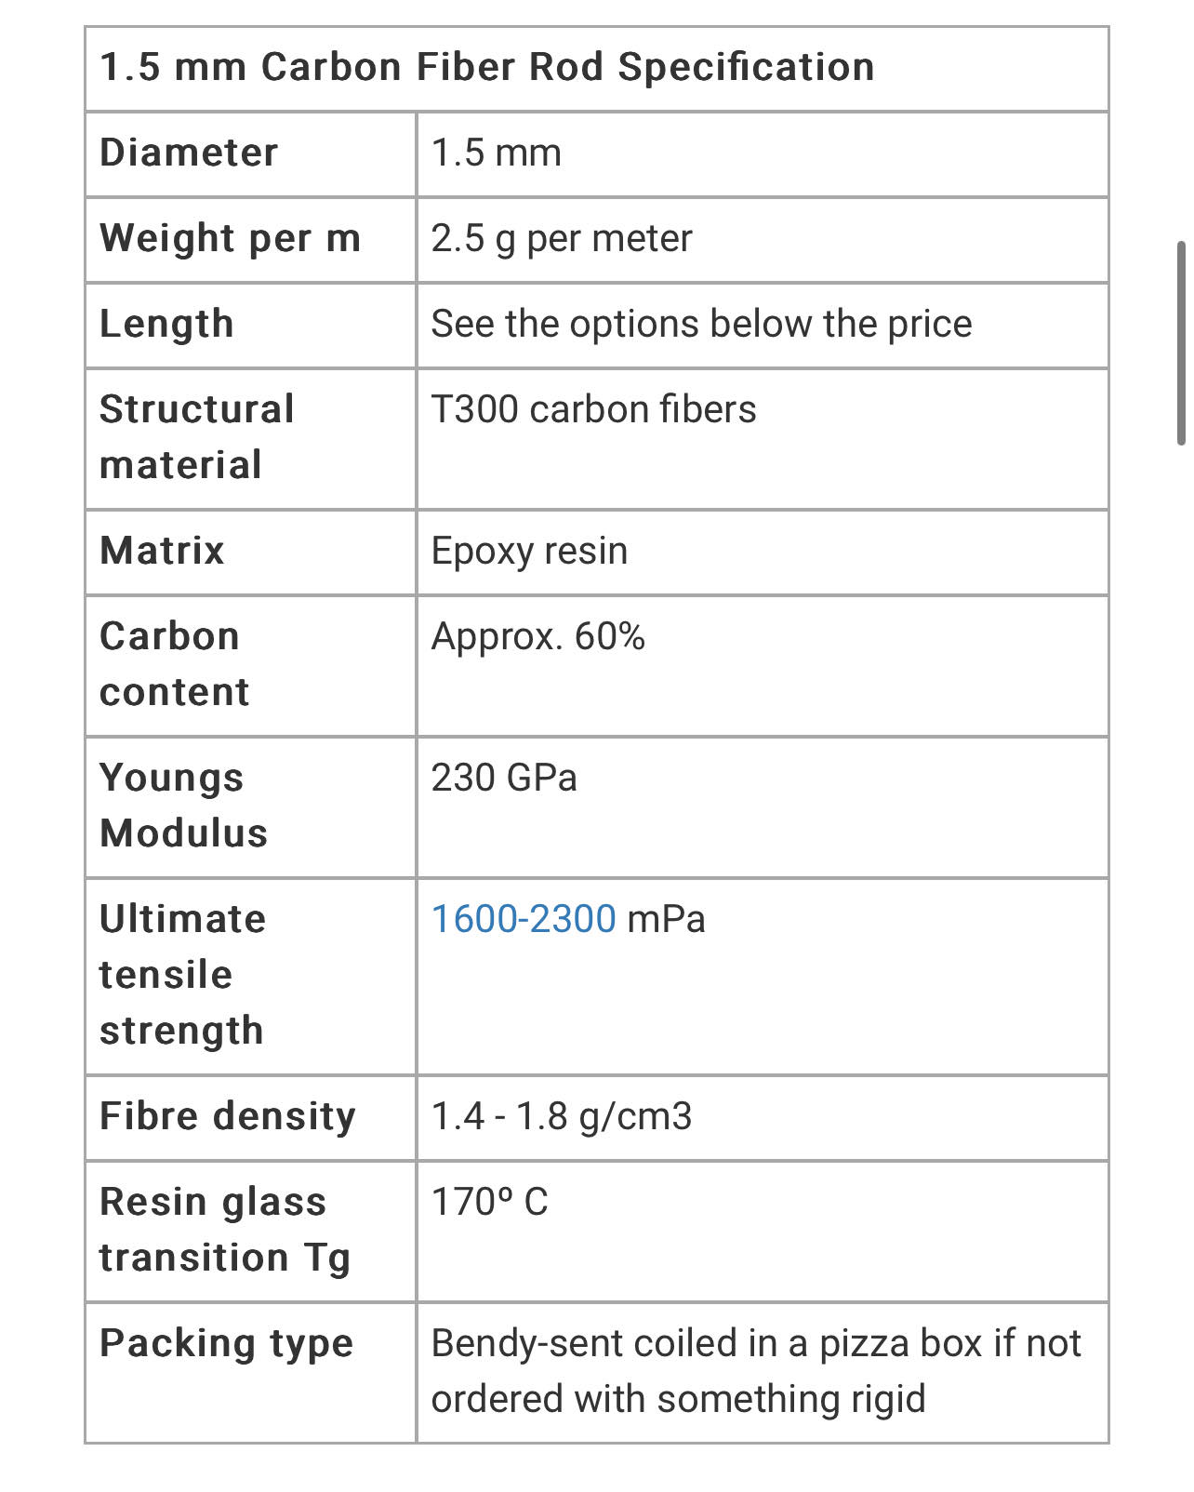
Rod Parameters
https://www.hyperflight.co.uk/products.asp?code=CARBON-ROD-15MM&name=1-5mm-carbon-rod&fbclid=IwAR38WoZ2lWlQhBS_eNL4IRFo6Wo-6U4sWvSkZ6Svug4WLcLmZKkoAdgomUQ

